Slide 1
Lecture 5: Linear Regression, kNN Regression and Inference

Slide 2
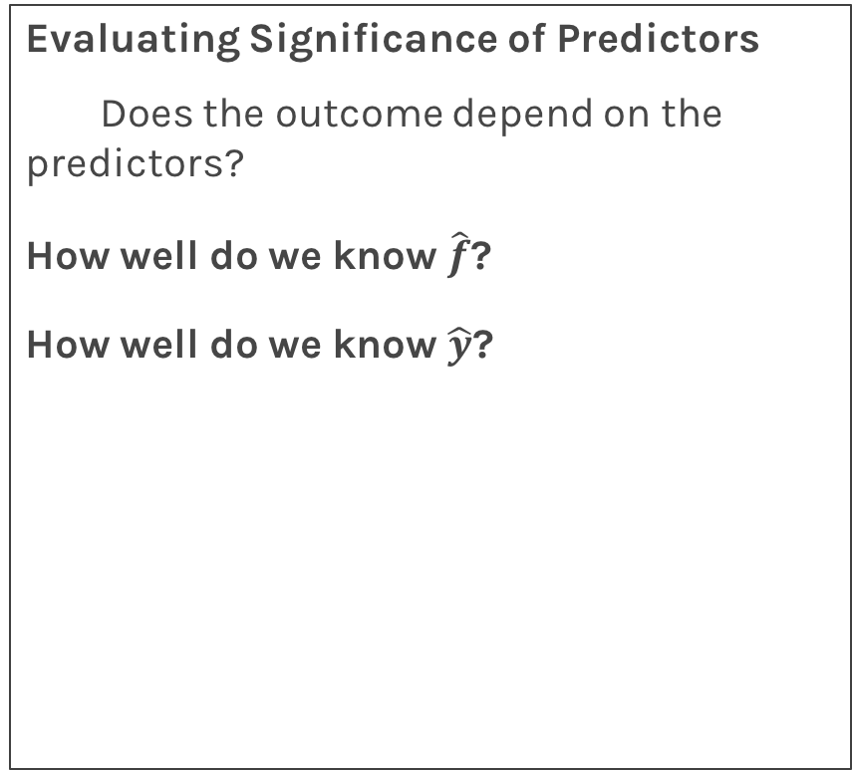
Lecture Outline
Evaluating Significance of Predictors
Does the outcome depend on the predictors?
How well do we know $\hat{f}$?
How well do we know $\hat{y}$?
Hypothesis Testing
Confidence Intervals

Slide 3
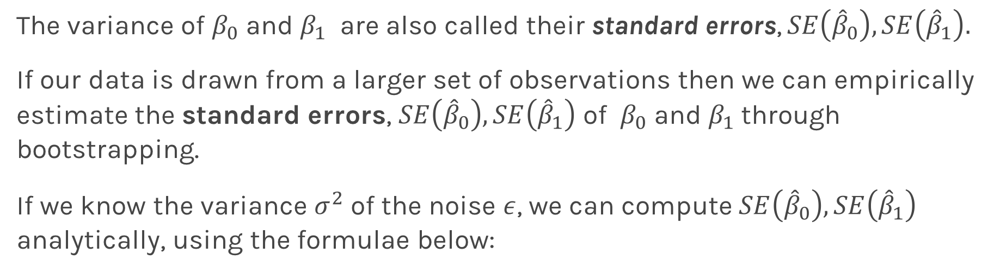
Standard Errors
The variance of $β_{0}$ and $β_{1}$ are also called their standard errors, $SE\left({\hat{β}}_{0}\right),SE\left({\hat{β}}_{1}\right).$
If our data is drawn from a larger set of observations then we can empirically estimate the standard errors, $SE\left({\hat{β}}_{0}\right),SE\left({\hat{β}}_{1}\right)$ of $β_{0}$ and $β_{1}$through bootstrapping.
If we know the variance $σ^{2}$ of the noise $ε$, we can compute $SE\left({\hat{β}}_{0}\right),SE\left({\hat{β}}_{1}\right)$ analytically, using the formulae below:
Notes:
If data set is small this approximation does not work

Slide 4
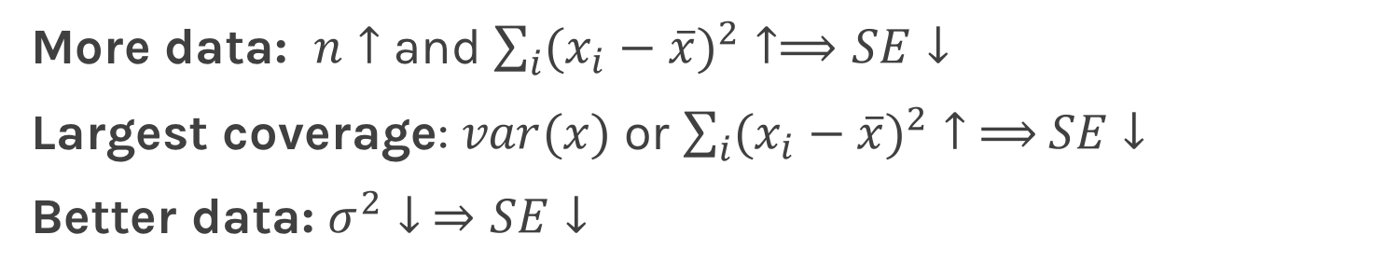
Standard Errors
More data: $n↑$ and $\sum_{i}{({x_{i}−\overline{x})}^{2}}↑⟹SE↓$
Largest coverage: $var(x)$ or $\sum_{i}{({x_{i}−\overline{x})}^{2}}↑ ⟹$ $SE↓$
Better data: $σ^{2}↓ ⇒SE↓$
Notes:
If data set is small this approximation does not work

Slide 5
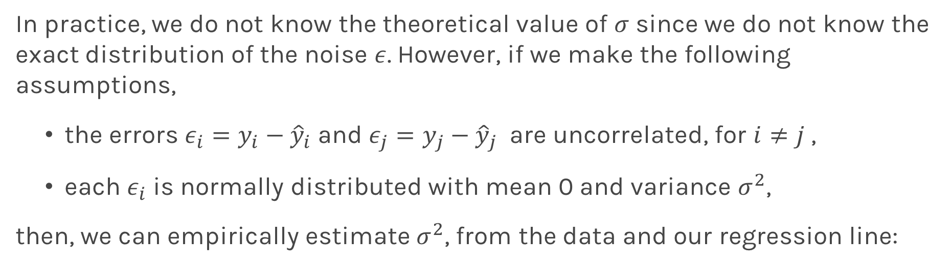
Standard Errors
In practice, we do not know the theoretical value of $σ$ since we do not know the exact distribution of the noise $ε$. However, if we make the following assumptions,
the errors $ε_{i}=y_{i}−{\hat{y}}_{i}$and $ε_{j}=y_{j}−{\hat{y}}_{j}$ are uncorrelated, for $i≠j$ ,
each $ε_{i}$ is normally distributed with mean 0 and variance $σ^{2}$,
then, we can empirically estimate $σ^{2}$, from the data and our regression line:

Slide 6

Standard Errors
More data: $n↑$ and $\sum_{i}{({x_{i}−\overline{x})}^{2}}↑⟹SE↓$
Largest coverage: $var(x)$ or $\sum_{i}{({x_{i}−\overline{x})}^{2}}↑ ⟹$ $SE↓$
Better data: $σ^{2}↓ ⇒SE↓$
Better model: $(\hat{f}−y_{i}) ↓$ $⟹σ↓ ⟹SE↓$
Question: What happens to the $\hat{β_{0}}$, $\hat{β_{1}}$ under these scenarios?

Slide 7
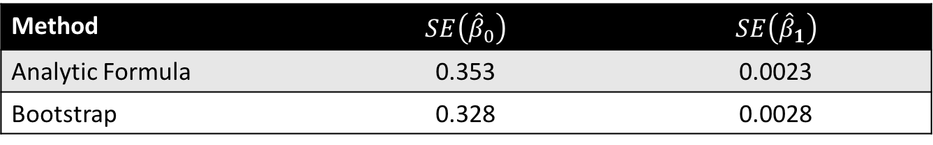
Standard Errors
The following results for the coefficients for TV advertising.
Method | $$SE\left({\hat{β}}_{0}\right)$$ | $$SE\left({\hat{β}}_{1}\right)$$
Analytic Formula | 0.353 | 0.0023
Bootstrap | 0.328 | 0.0028
The coefficients for TV advertising but restricting the coverage of x
The coefficients for TV advertising but added noise

Slide 8
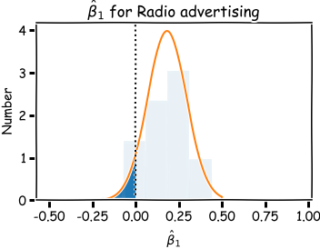
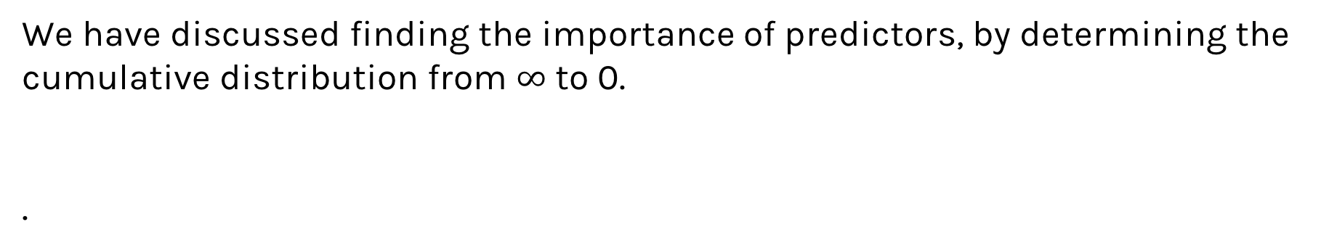
Importance of predictors
We have discussed finding the importance of predictors, by determining the cumulative distribution from $∞$ to 0.
.

Slide 9
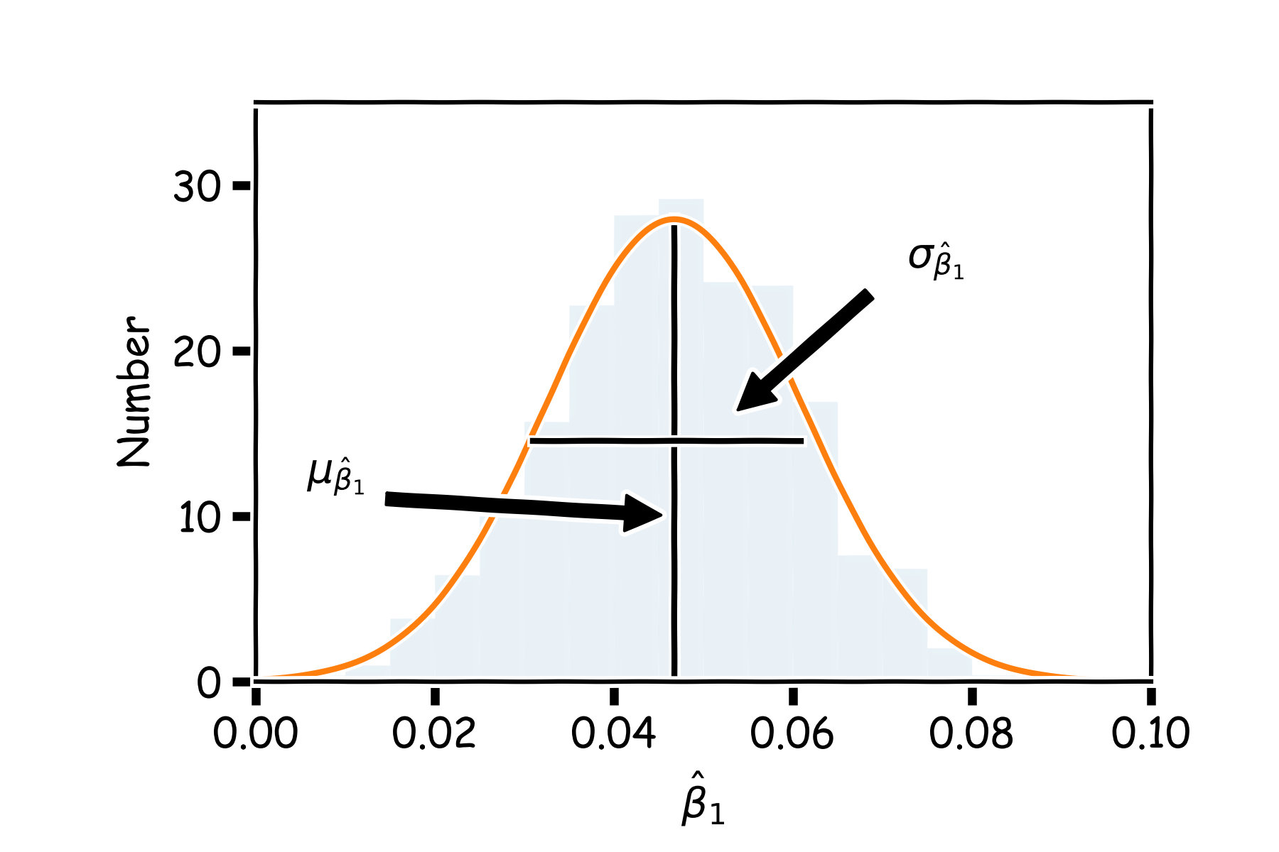
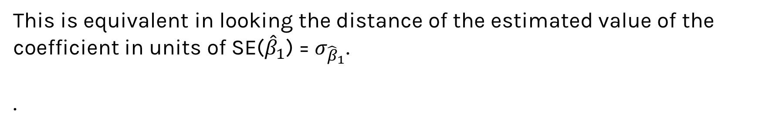
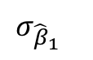
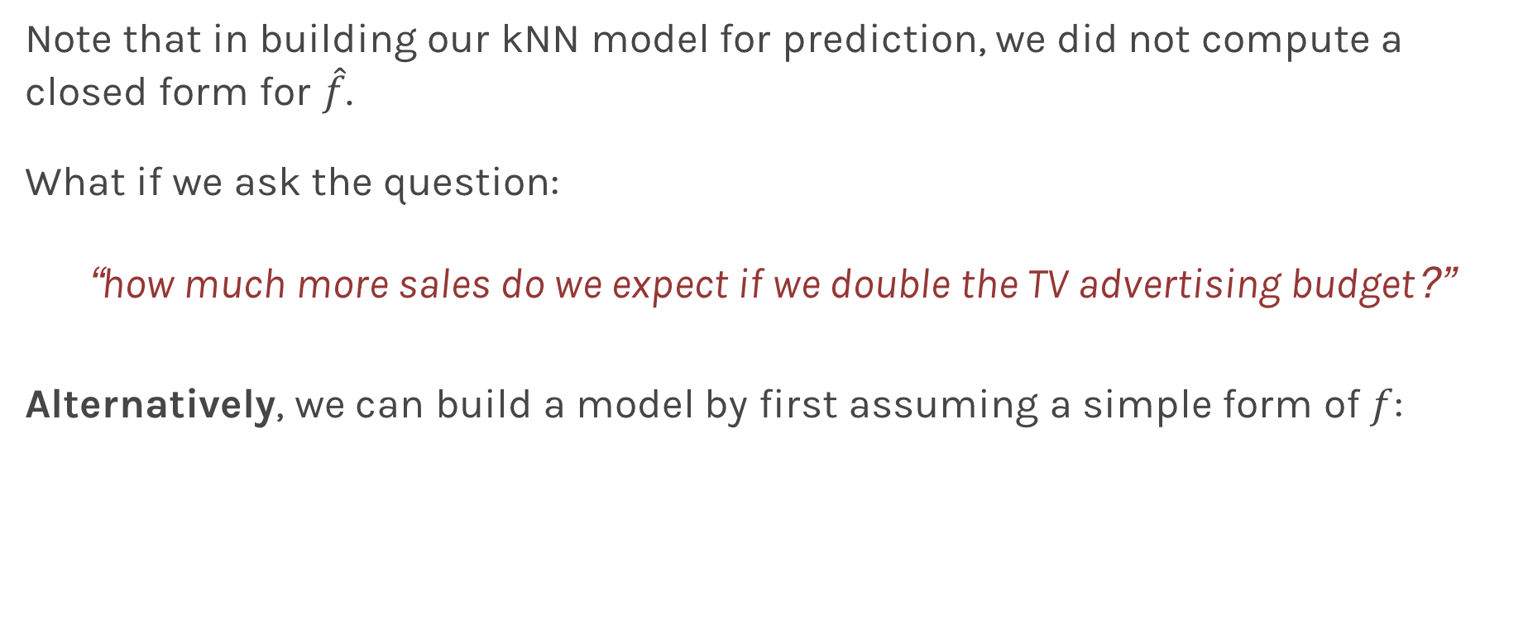
Importance of predictors
This is equivalent in looking the distance of the estimated value of the coefficient in units of SE(${\hat{β}}_{1}$) = $σ_{{\hat{β}}_{1}}$.
.
$$μ_{{\hat{β}}_{1}}−0$$
$$σ_{{\hat{β}}_{1}}$$

Slide 10
Hypothesis Testing
Hypothesis testing is a formal process through which we evaluate the validity of a statistical hypothesis by considering evidence for or against the hypothesis gathered by random sampling of the data.

Slide 11
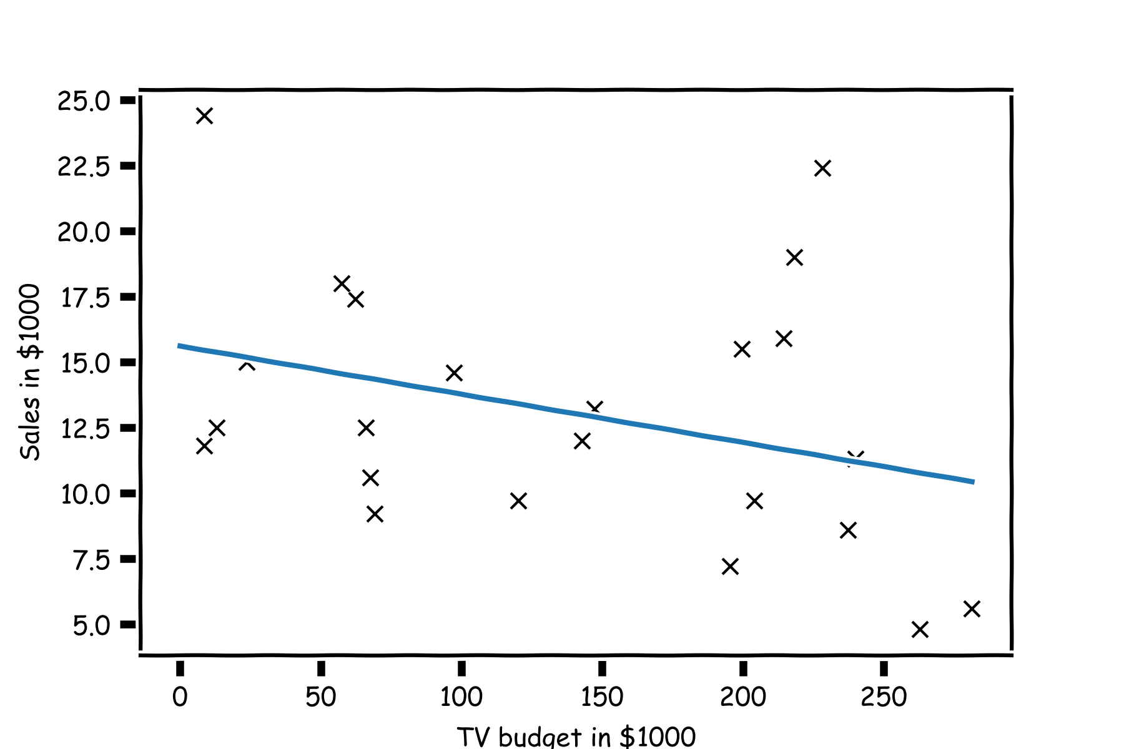
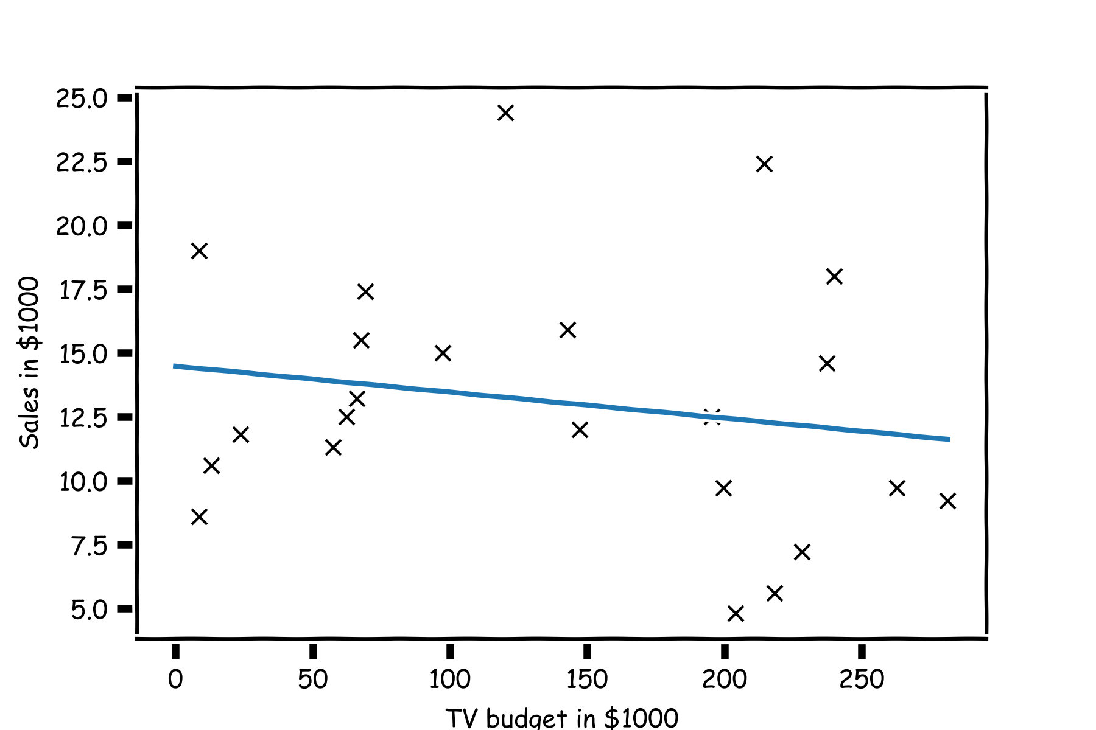
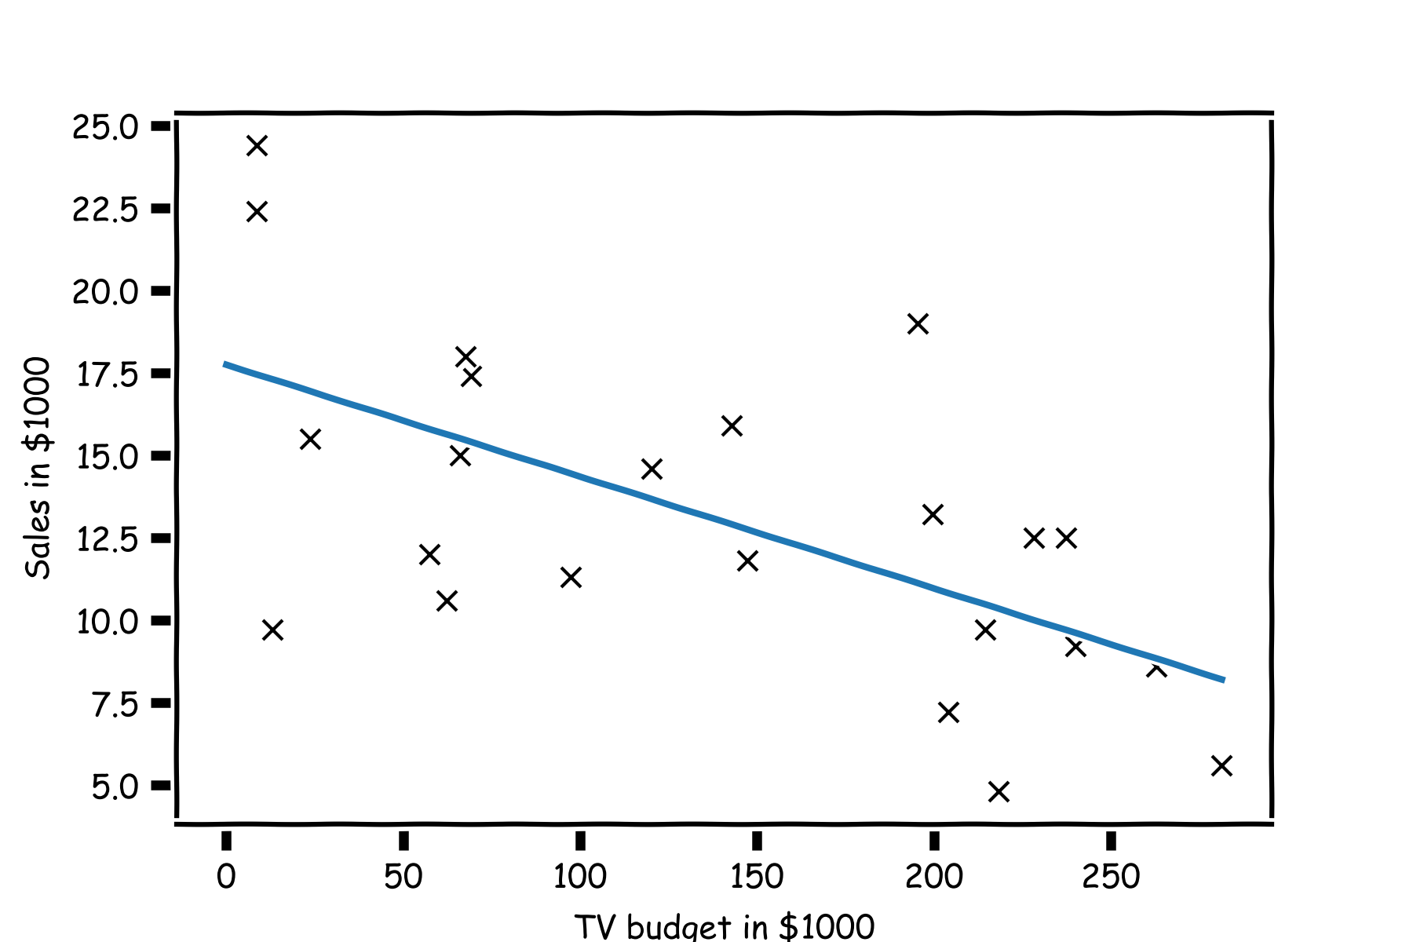
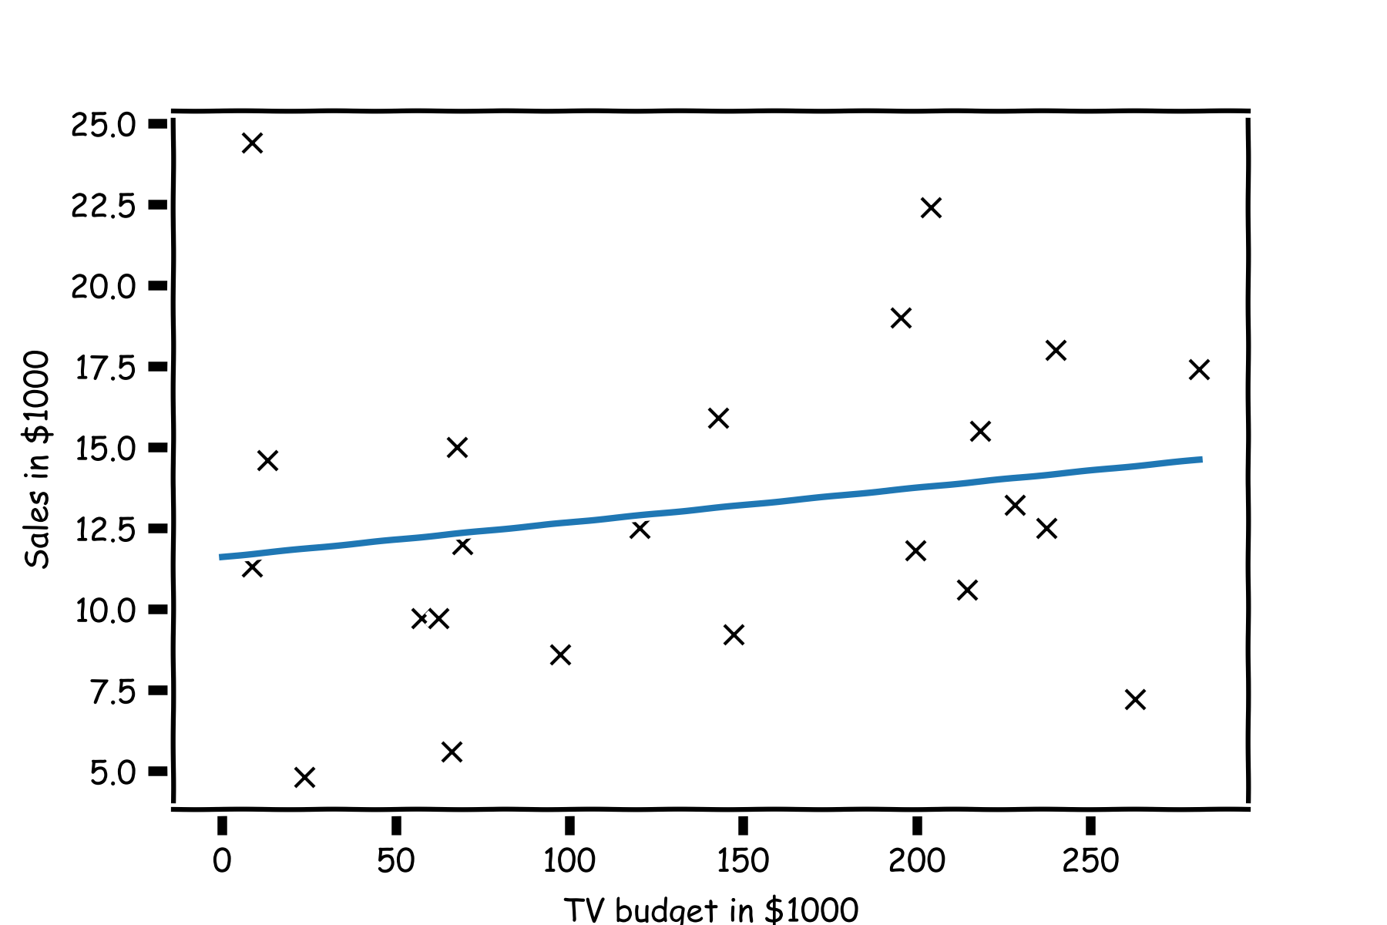
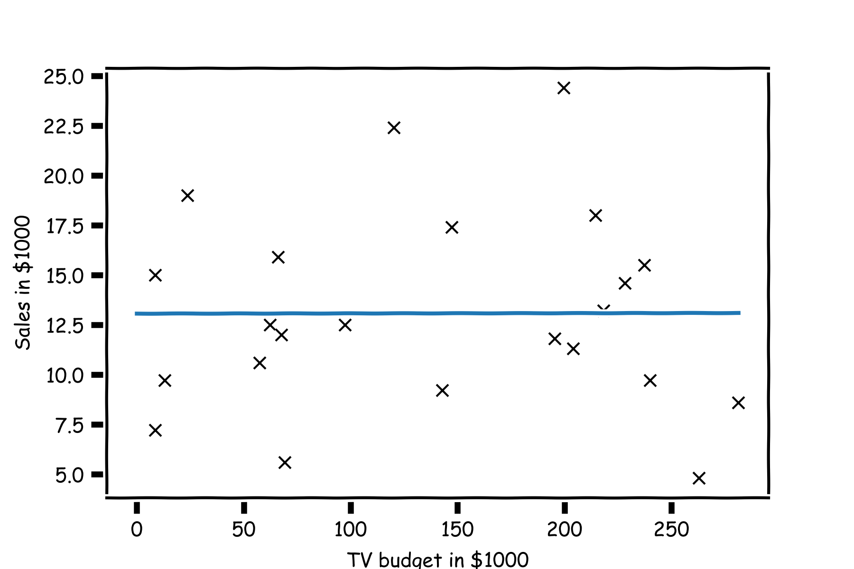
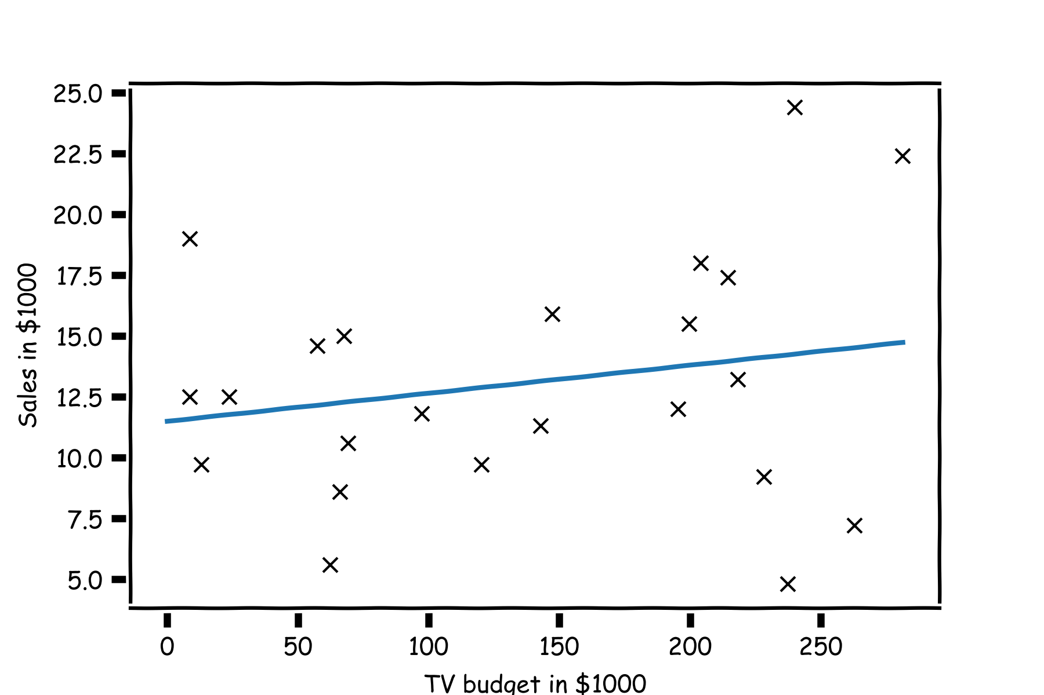
TV | sales
68.4 | 22.1
202.5 | 10.4
248.8 | 9.3
191.1 | 18.5
23.8 | 12.9
296.4 | 7.2
26.8 | 11.8
164.5 | 13.2
209.6 | 4.8
147.3 | 10.6
139.2 | 8.6
109.8 | 17.4
43.0 | 9.2
73.4 | 9.7
262.7 | 19.0
28.6 | 22.4
135.2 | 12.5
240.1 | 24.4
TV | sales
50.0 | 22.1
184.9 | 10.4
11.7 | 9.3
219.8 | 18.5
13.1 | 12.9
248.8 | 7.2
76.4 | 11.8
197.6 | 13.2
195.4 | 4.8
75.5 | 10.6
238.2 | 8.6
222.4 | 17.4
171.3 | 9.2
184.9 | 9.7
193.2 | 19.0
131.7 | 22.4
116.0 | 12.5
166.8 | 24.4
TV | sales
88.3 | 22.1
102.7 | 10.4
204.1 | 9.3
39.5 | 18.5
68.4 | 12.9
59.6 | 7.2
70.6 | 11.8
265.2 | 13.2
292.9 | 4.8
76.4 | 10.6
80.2 | 8.6
182.6 | 17.4
112.9 | 9.2
199.1 | 9.7
147.3 | 19.0
89.7 | 22.4
225.8 | 12.5
193.2 | 24.4
TV | sales
215.4 | 22.1
89.7 | 10.4
68.4 | 9.3
75.3 | 18.5
142.9 | 12.9
220.3 | 7.2
255.4 | 11.8
139.5 | 13.2
237.4 | 4.8
16.9 | 10.6
13.1 | 8.6
218.5 | 17.4
147.3 | 9.2
25.6 | 9.7
216.4 | 19.0
238.2 | 22.4
213.4 | 12.5
109.8 | 24.4
TV | sales
216.4 | 22.1
276.7 | 10.4
23.8 | 9.3
13.2 | 18.5
26.8 | 12.9
170.2 | 7.2
0.7 | 11.8
87.2 | 13.2
120.5 | 4.8
293.6 | 10.6
78.2 | 8.6
43.0 | 17.4
139.2 | 9.2
276.9 | 9.7
239.3 | 19.0
191.1 | 22.4
25.1 | 12.5
25.6 | 24.4
TV | sales
230.1 | 22.1
44.5 | 10.4
17.2 | 9.3
151.5 | 18.5
180.8 | 12.9
8.7 | 7.2
57.5 | 11.8
120.2 | 13.2
8.6 | 4.8
199.8 | 10.6
66.1 | 8.6
214.7 | 17.4
23.8 | 9.2
97.5 | 9.7
204.1 | 19.0
195.4 | 22.4
67.8 | 12.5
281.4 | 24.4

Slide 12
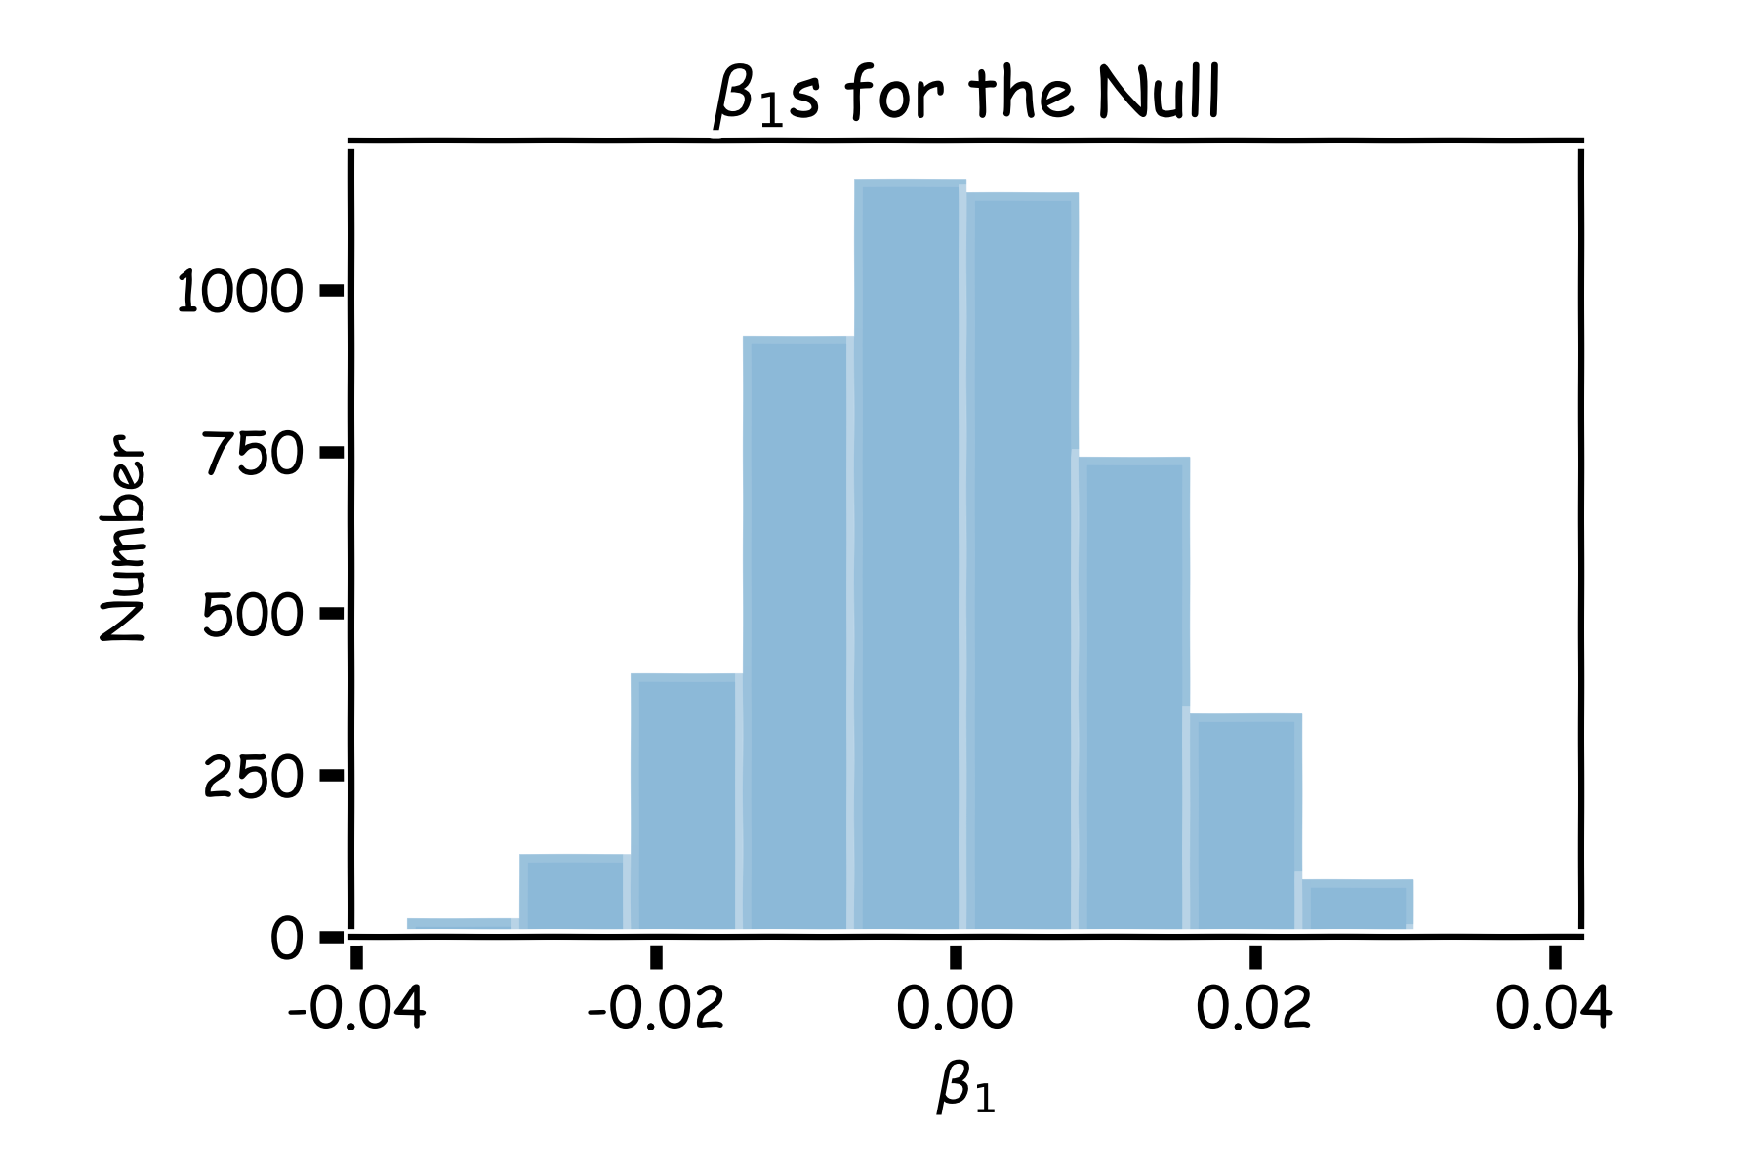
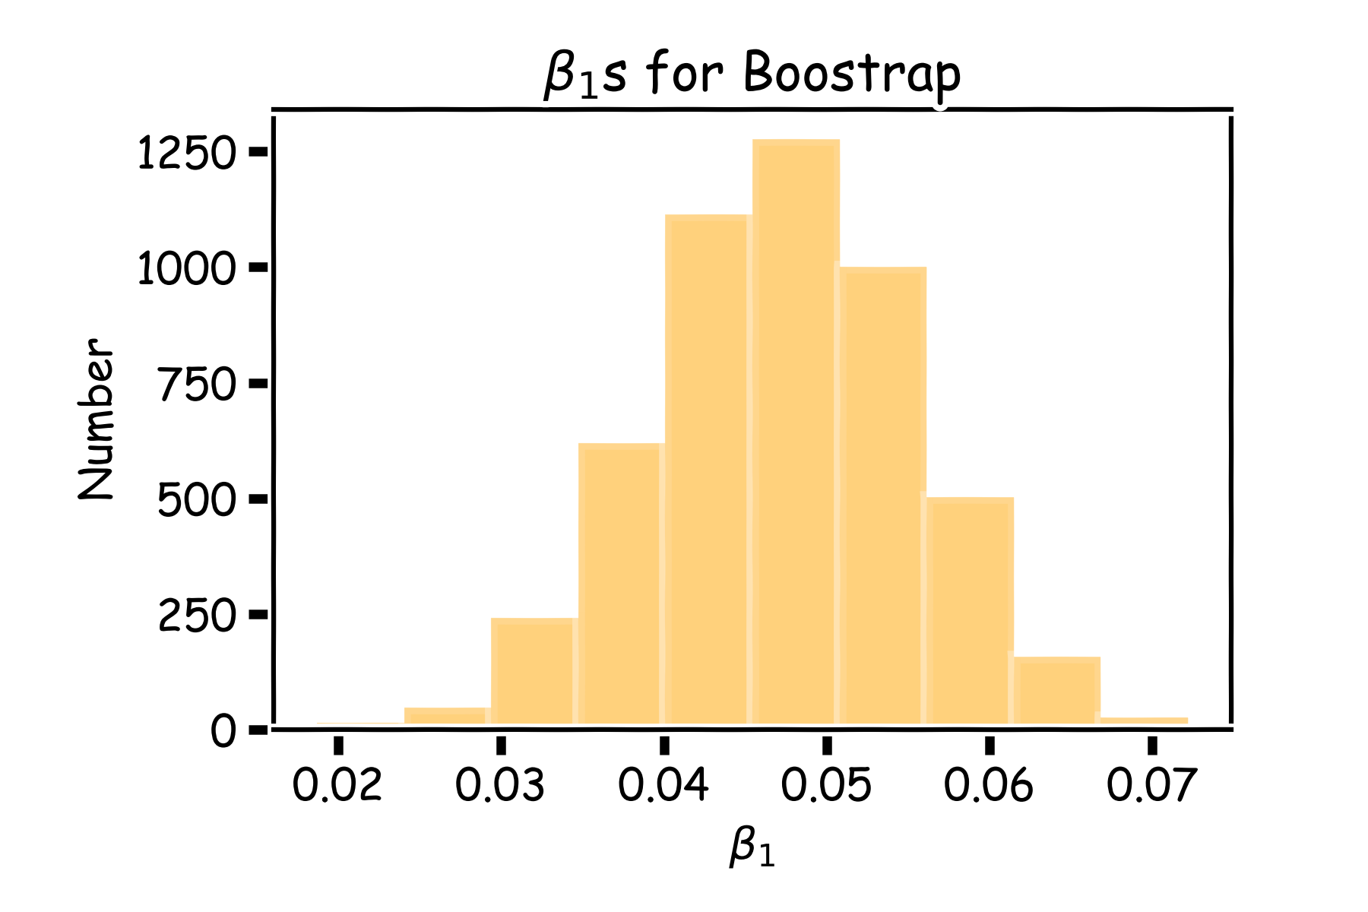
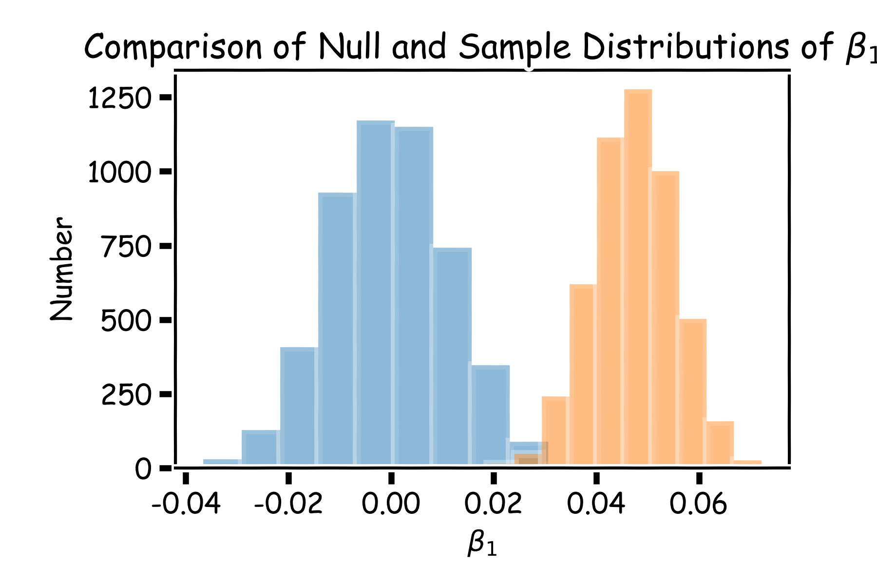

Slide 13
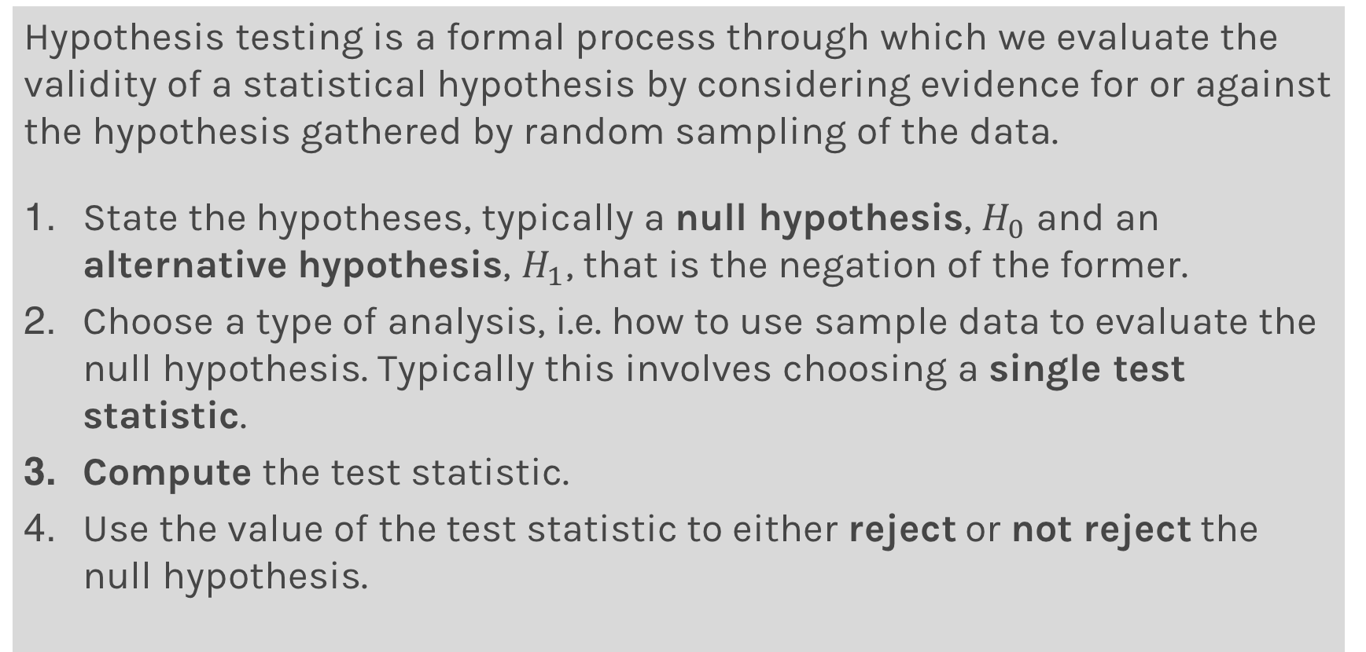
Hypothesis Testing
Hypothesis testing is a formal process through which we evaluate the validity of a statistical hypothesis by considering evidence for or against the hypothesis gathered by random sampling of the data.
State the hypotheses, typically a null hypothesis, $H_{0}$ and an alternative hypothesis, $H_{1}$, that is the negation of the former.
Choose a type of analysis, i.e. how to use sample data to evaluate the null hypothesis. Typically this involves choosing a single test statistic.
Compute the test statistic.
Use the value of the test statistic to either reject or not reject the null hypothesis.

Slide 14
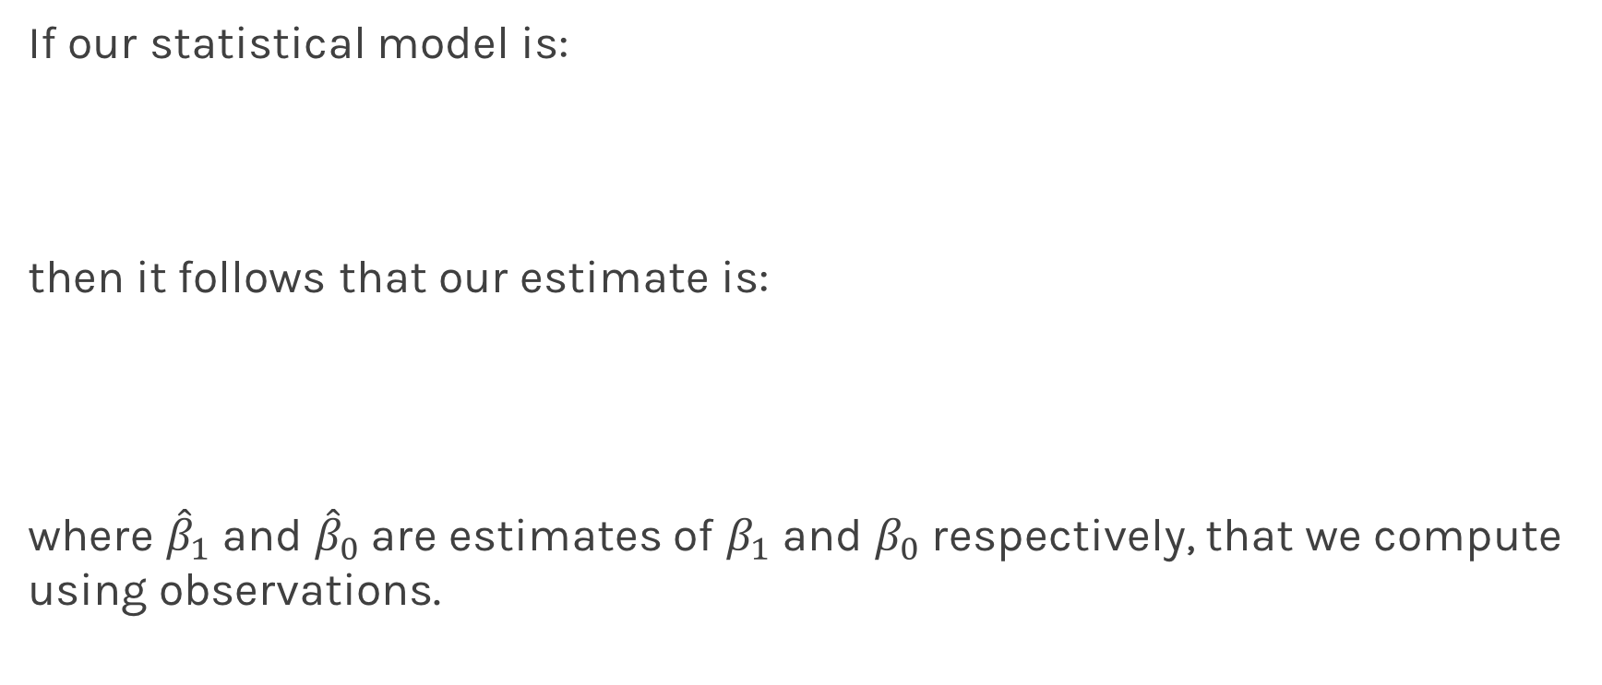
Hypothesis testing
1. State Hypothesis:
Null hypothesis:
$H_{0}$: There is no relation between X and Y
The alternative:
$H_{a}$: There is some relation between X and Y
2: Choose test statistics
To test the null hypothesis, we need to determine whether, our estimate for ${\hat{β}}_{1}$, is sufficiently far from zero that we can be confident that ${\hat{β}}_{1}$ is non-zero. We use the following test statistic:

Slide 15
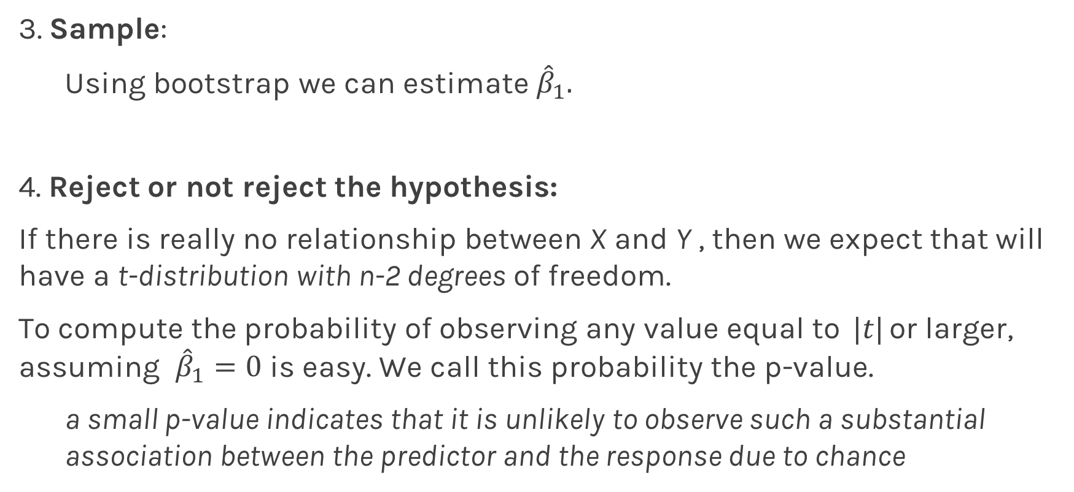
Hypothesis testing
3. Sample:
Using bootstrap we can estimate ${\hat{β}}_{1}.$
4. Reject or not reject the hypothesis:
If there is really no relationship between X and Y , then we expect that will have a t-distribution with n-2 degrees of freedom.
To compute the probability of observing any value equal to $|t|$ or larger, assuming ${\hat{β}}_{1}=0$ is easy. We call this probability the p-value.
a small p-value indicates that it is unlikely to observe such a substantial association between the predictor and the response due to chance

Slide 16
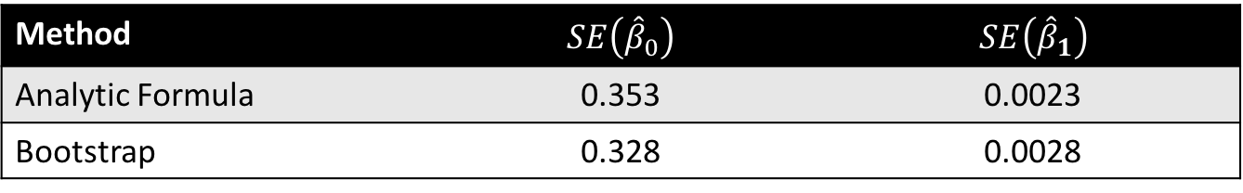

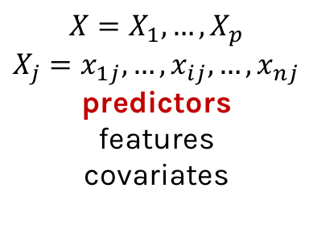
Hypothesis testing
P-values for all three predictors done independently
Method | $$SE\left({\hat{β}}_{0}\right)$$ | $$SE\left({\hat{β}}_{1}\right)$$
Analytic Formula | 0.353 | 0.0023
Bootstrap | 0.328 | 0.0028
Method | $$SE\left({\hat{β}}_{0}\right)$$ | $$SE\left({\hat{β}}_{1}\right)$$
Analytic Formula | 0.353 | 0.0023
Bootstrap | 0.328 | 0.0028
Method | $$SE\left({\hat{β}}_{0}\right)$$ | $$SE\left({\hat{β}}_{1}\right)$$
Analytic Formula | 0.353 | 0.0023
Bootstrap | 0.328 | 0.0028

Slide 17
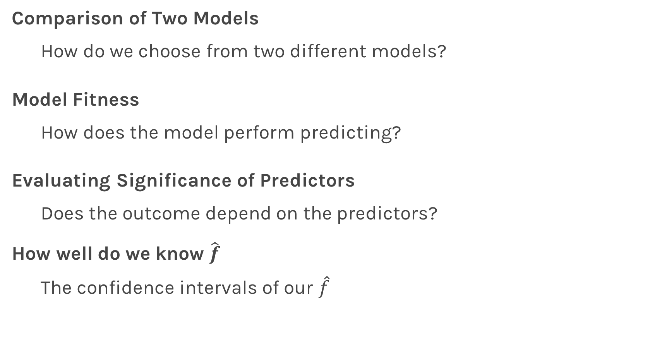
Things to Consider
Comparison of Two Models
How do we choose from two different models?
Model Fitness
How does the model perform predicting?
Evaluating Significance of Predictors
Does the outcome depend on the predictors?
How well do we know $\hat{f}$
The confidence intervals of our $\hat{f}$

Slide 18
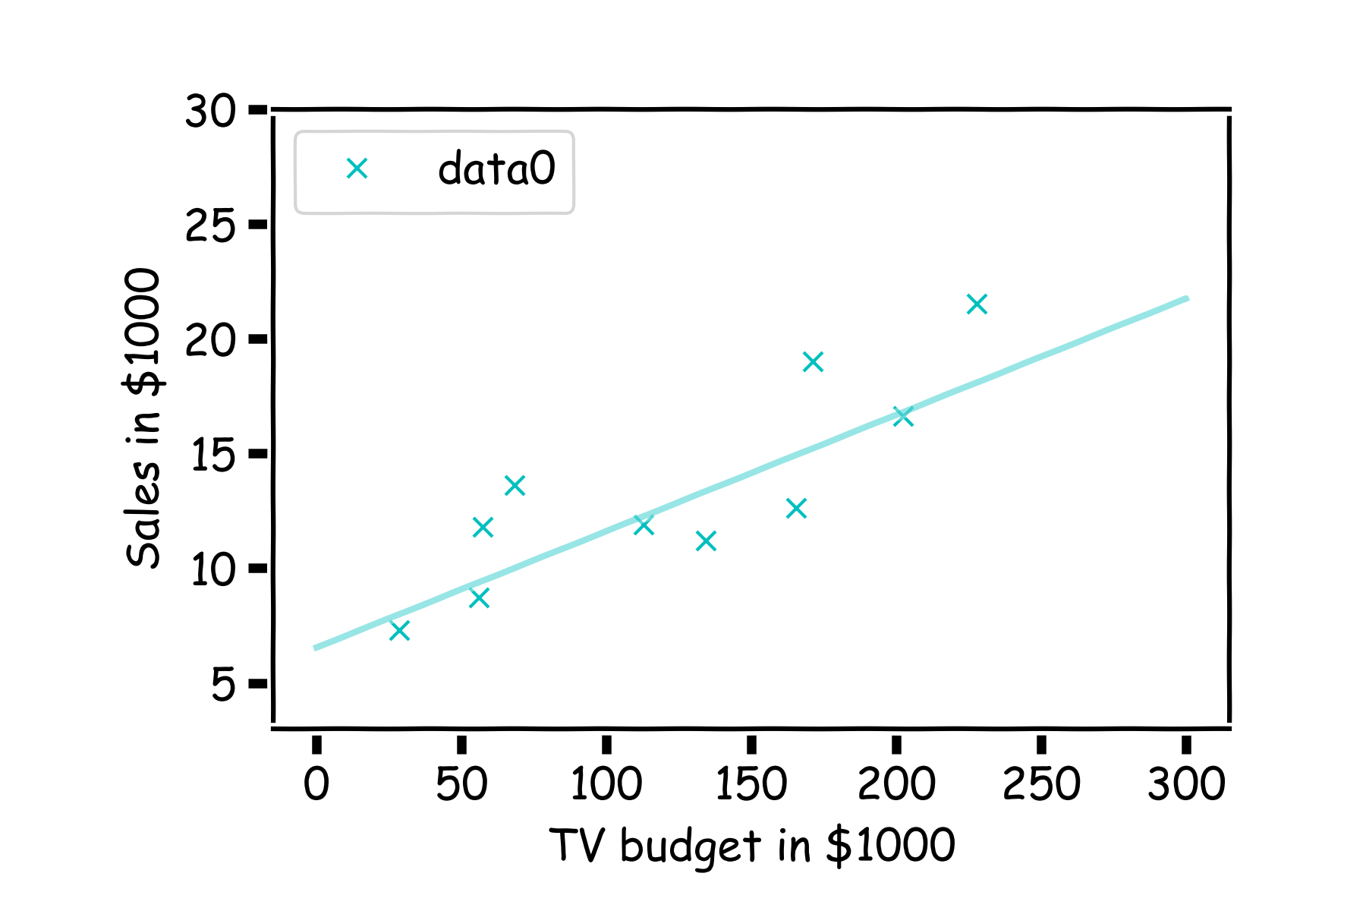
How well do we know $\hat{f}$?
Our confidence in $f$ is directly connected with the confidence in $β$s. So for each $β$ we can determine the model.

Slide 19
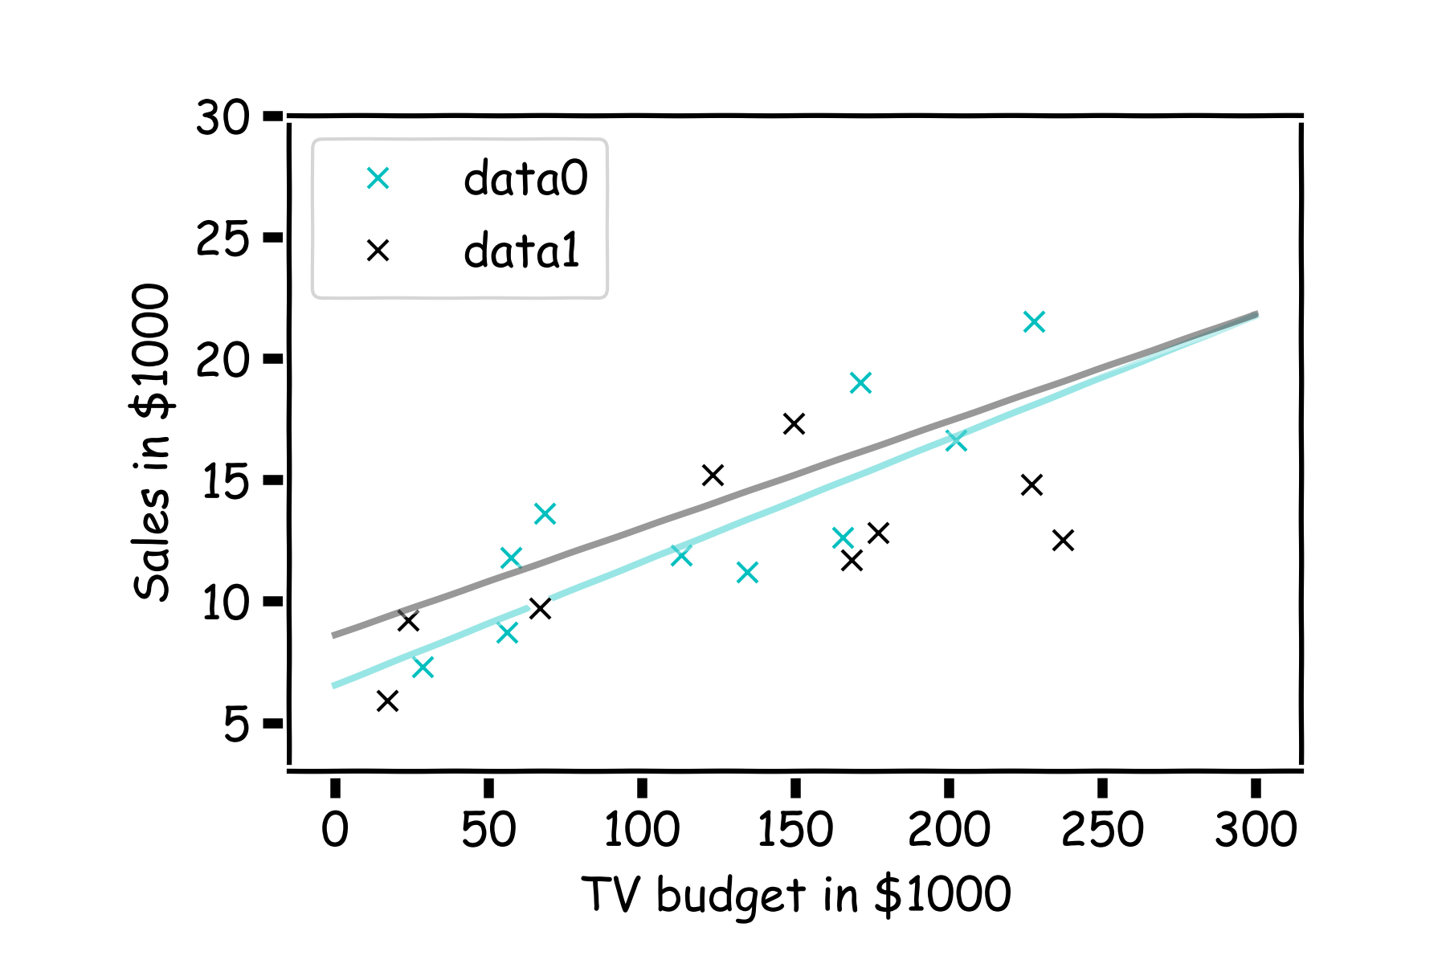
How well do we know $\hat{f}$?
Here we show two difference set of models given the fitted coefficients for a given subsample

Slide 20
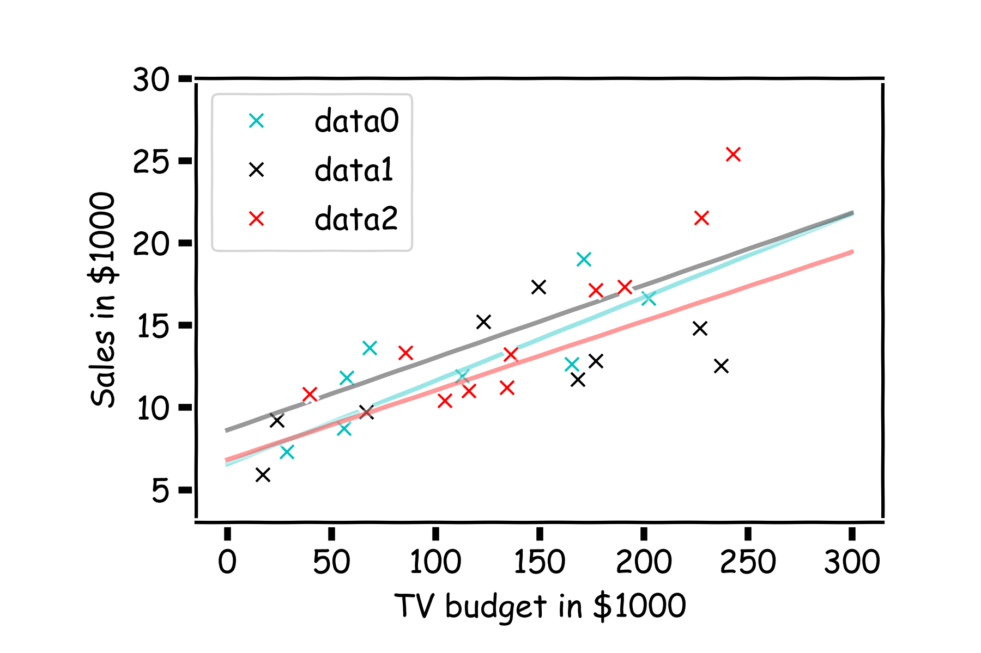
How well do we know $\hat{f}$?
There is one such regression line for every imaginable sub-sample.

Slide 21
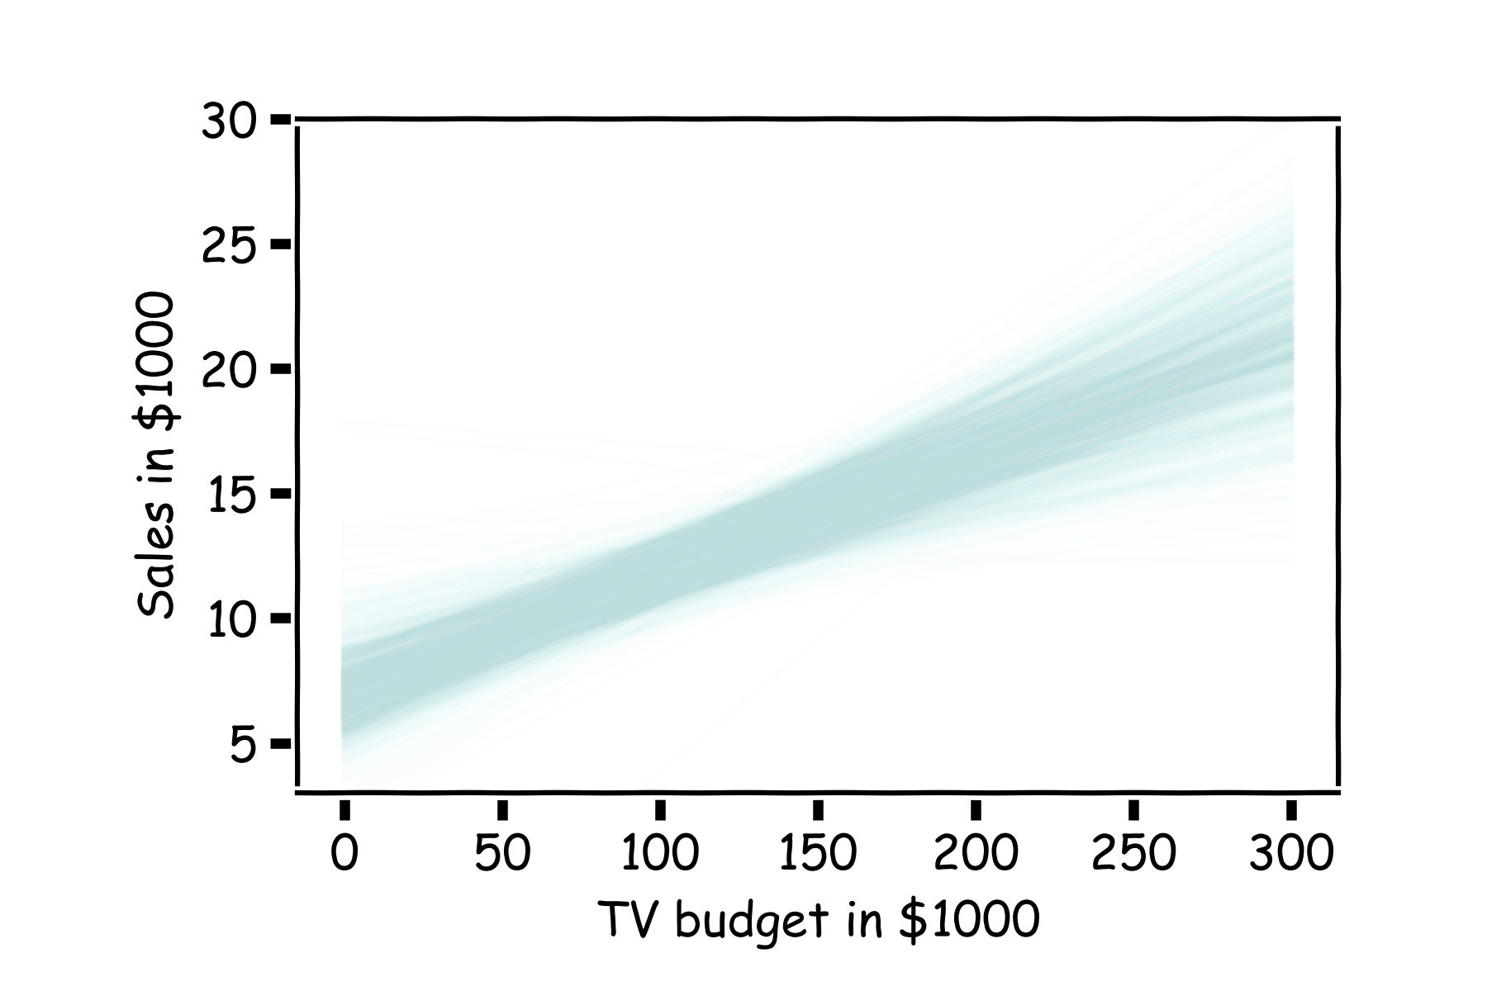
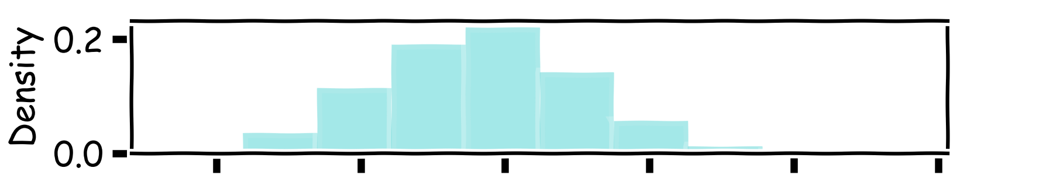
How well do we know $\hat{f}$?
Below we show all regression lines for a thousand of such sub-samples.
For a given $x$, we examine the distribution of $\hat{f}$, and determine the mean and standard deviation.

Slide 22
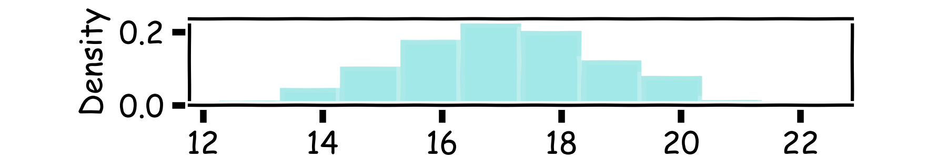
How well do we know $\hat{f}$?
Below we show all regression lines for a thousand of such sub-samples.
For a given $x$, we examine the distribution of $\hat{f}$, and determine the mean and standard deviation.

Slide 23
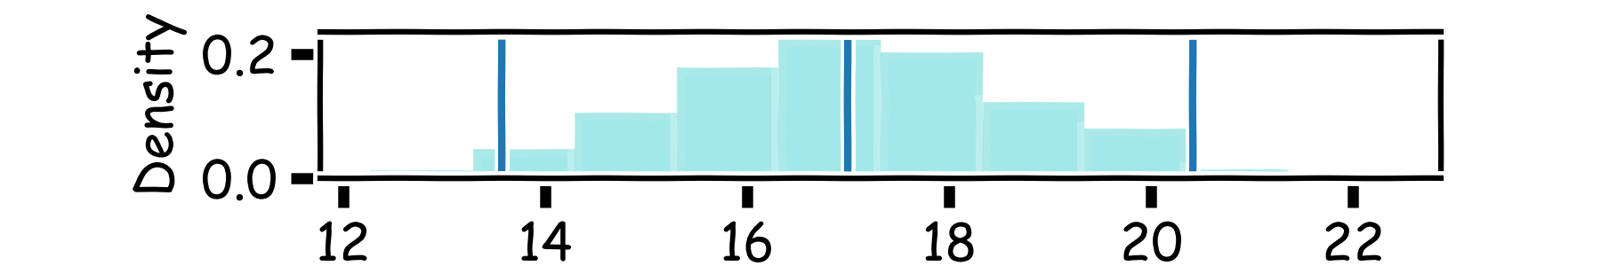
How well do we know $\hat{f}$?
Below we show all regression lines for a thousand of such sub-samples.
For a given $x$, we examine the distribution of $\hat{f}$, and determine the mean and standard deviation.

Slide 24
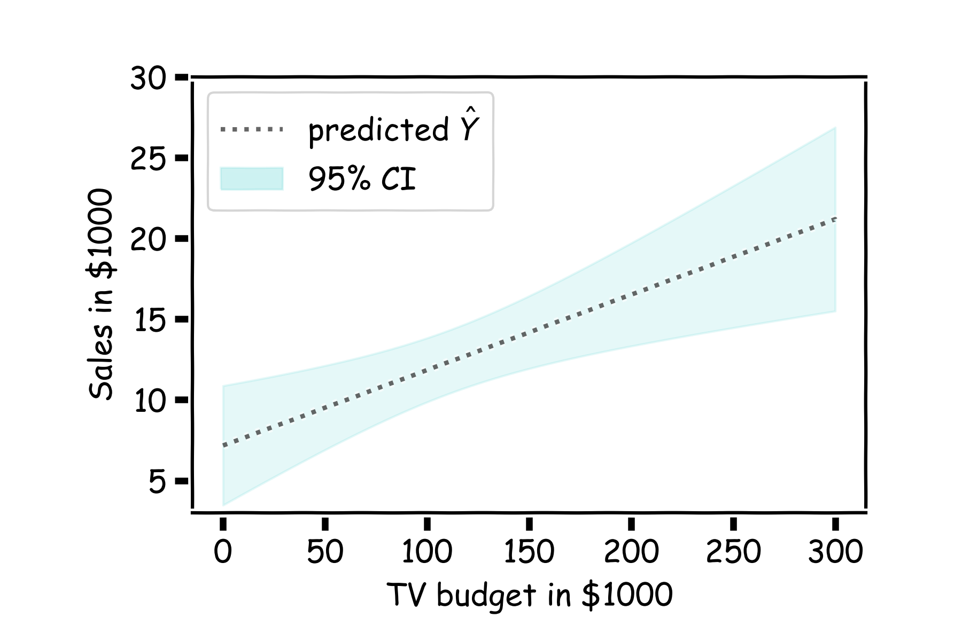
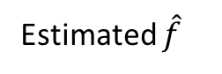
How well do we know $\hat{f}$?
For every $x$, we calculate the mean of the models, $\hat{f}$ (shown with dotted line) and the 95% CI of those models (shaded area).
Estimated $\hat{f}$

Slide 25
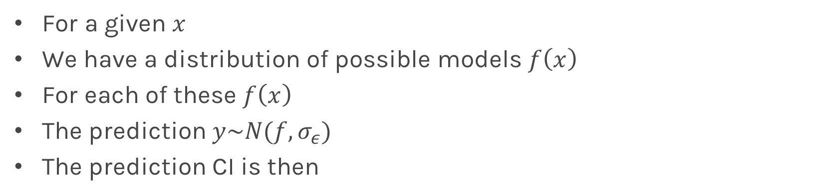

Confidence in predicting $\hat{y}$
For a given $x$
We have a distribution of possible models $f\left(x\right)$
For each of these $f\left(x\right)$
The prediction $y\sim N(f, σ_{ε})$
The prediction CI is then
Estimated $\hat{f}$

Slide 26
Multiple Linear Regression

Slide 27
Response vs. Predictor Variables
X
predictors
features
covariates
Y
outcome
response variable
dependent variable
TV | radio | newspaper | sales
230.1 | 37.8 | 69.2 | 22.1
44.5 | 39.3 | 45.1 | 10.4
17.2 | 45.9 | 69.3 | 9.3
151.5 | 41.3 | 58.5 | 18.5
180.8 | 10.8 | 58.4 | 12.9
n observations
p predictors

Slide 28
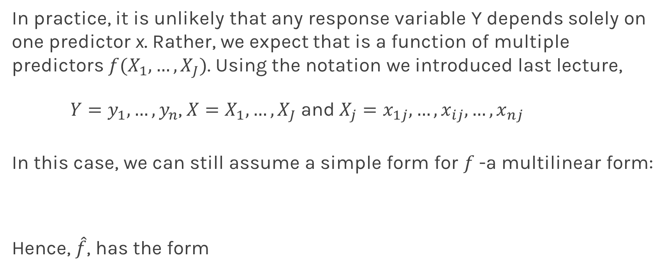
Multilinear Models
In practice, it is unlikely that any response variable Y depends solely on one predictor x. Rather, we expect that is a function of multiple predictors $f(X_{1},…,X_{J})$. Using the notation we introduced last lecture,
$Y=y_{1},…,y_{n}$, $X=X_{1},…,X_{J}$and$X_{j}=x_{1j},…,x_{ij},…,x_{nj}$
In this case, we can still assume a simple form for $f$-a multilinear form:
Hence, $\hat{f}$, has the form
Notes:
We need a figure here

Slide 29
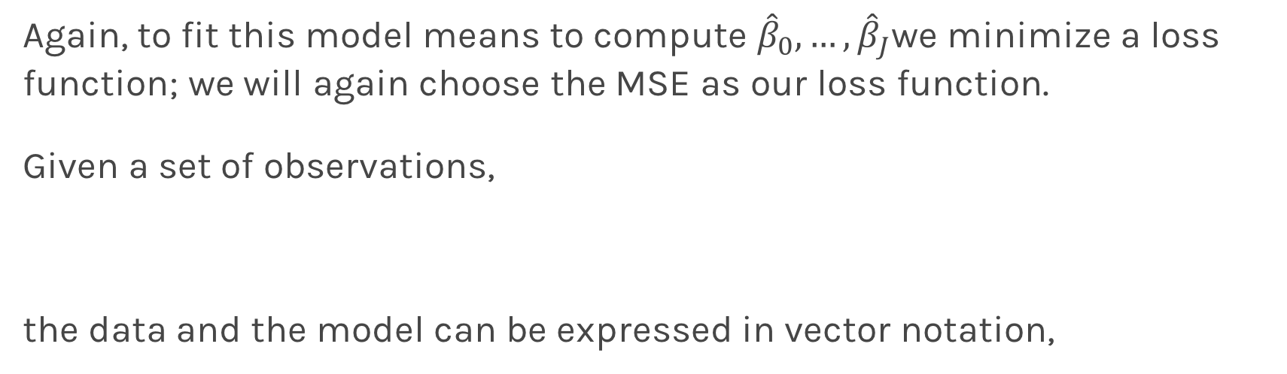
Multiple Linear Regression
Again, to fit this model means to compute ${\hat{β}}_{0},…,{\hat{β}}_{J}$we minimize a loss function; we will again choose the MSE as our loss function.
Given a set of observations,
the data and the model can be expressed in vector notation,
Notes:
We need a figure here

Slide 30
Multiple Linear Regression
The model takes a simple algebraic form:
Thus, the MSE can be expressed in vector notation as
Minimizing the MSE using vector calculus yields,
Notes:
We need a figure here

Slide 31
Collinearity
Collinearity refers to the case in which two or more predictors are correlated (related).
Overfitting … var bias trade off blah blah
But how does it affect our confidence on the coefficients and consequently on the importance of those coefficients.
First let’s look some examples:
Notes:
We need a figure here

Slide 32
Coef. | Std.Err. | t | P>|t| | [0.025 | 0.975]
11.55 | 0.576554188988 | 20.0361887132 | 1.62722559358e-49 | 10.4149735963 | 12.6889234715
0.074 | 0.0144281960395 | 5.13469314148 | 6.73428060863e-07 | 0.0456317044844 | 0.102537014011
Coef. | Std.Err. | t | P>|t| | [0.025 | 0.975]
2.60222872901 | 0.332752161374 | 7.82032104094 | 3.17652059101e-13 | 1.94599447497 | 3.25846298305
0.0464989491226 | 0.00155580824791 | 29.8873265294 | 6.31479396275e-75 | 0.0434306755439 | 0.0495672227013
0.175603973868 | 0.00945311659644 | 18.5763046585 | 4.29766978055e-45 | 0.156961092955 | 0.194246854781
0.0136756963667 | 0.0058481432783 | 2.33846807711 | 0.0203708881969 | 0.00214233193739 | 0.025209060796
Coef. | Std.Err. | t | P>|t| | [0.025 | 0.975]
9.56718512073 | 0.55367507165 | 17.2794218317 | 2.13379646799e-41 | 8.4753282024 | 10.6590420391
0.195609208561 | 0.0207441358046 | 9.42961473081 | 1.13402268007e-17 | 0.154701410192 | 0.236517006931
Coef. | Std.Err. | t | P>|t| | [0.025 | 0.975]
6.67917313863 | 0.478527051508 | 13.9577754645 | 2.80480724756e-31 | 5.73550942944 | 7.62283684782
0.0483103275763 | 0.00279188112871 | 17.3038626464 | 1.80215061732e-41 | 0.0428046891944 | 0.0538159659581

Slide 33
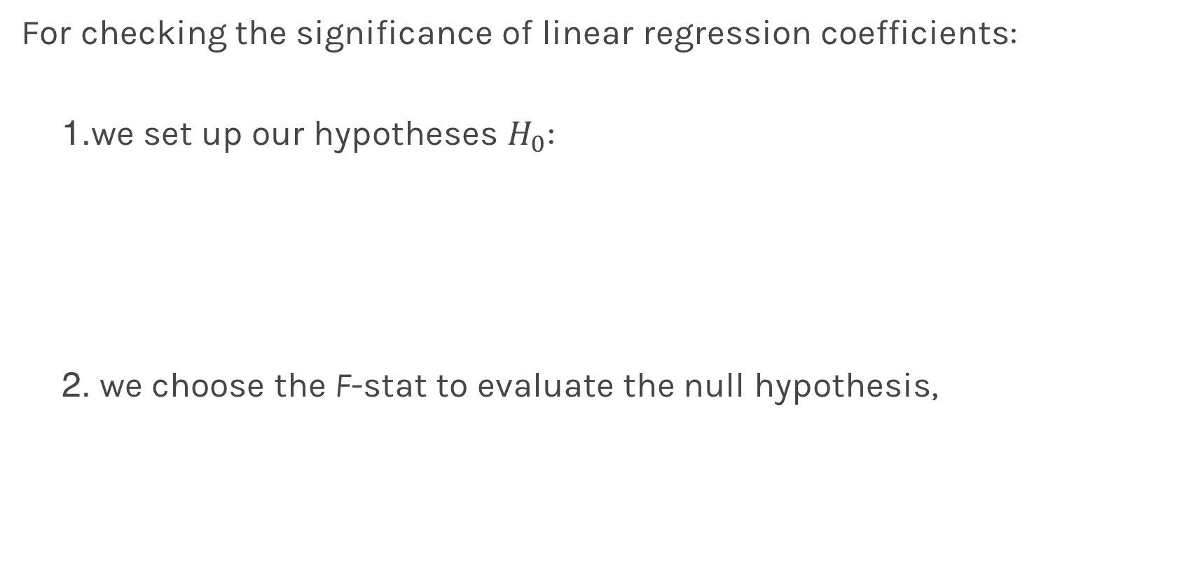
Finding Significant Predictors: Hypothesis Testing
For checking the significance of linear regression coefficients:
we set up our hypotheses $H_{0}$:
we choose the F-stat to evaluate the null hypothesis,

Slide 34
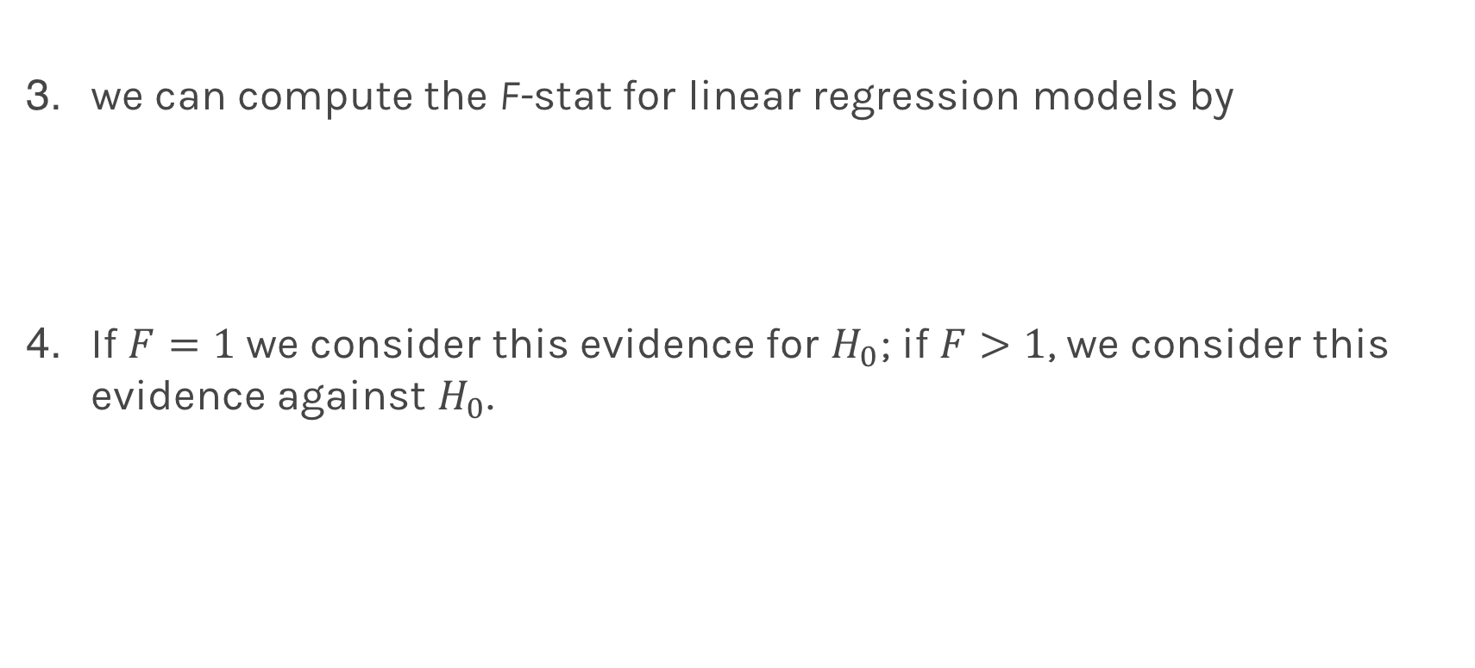
Finding Significant Predictors: Hypothesis Testing
we can compute the F-stat for linear regression models by
If $F=1$ we consider this evidence for $H_{0}$; if $F>1$, we consider this evidence against $H_{0}$.

Slide 35
Qualitative Predictors
So far, we have assumed that all variables are quantitative. But in practice, often some predictors are qualitative.
Example: The Credit data set contains information about balance, age, cards, education, income, limit , and rating for a number of potential customers.
Income | Limit | Rating | Cards | Age | Education | Gender | Student | Married | Ethnicity | Balance
14.890 | 3606 | 283 | 2 | 34 | 11 | Male | No | Yes | Caucasian | 333
106.02 | 6645 | 483 | 3 | 82 | 15 | Female | Yes | Yes | Asian | 903
104.59 | 7075 | 514 | 4 | 71 | 11 | Male | No | No | Asian | 580
148.92 | 9504 | 681 | 3 | 36 | 11 | Female | No | No | Asian | 964
55.882 | 4897 | 357 | 2 | 68 | 16 | Male | No | Yes | Caucasian | 331

Slide 36
Qualitative Predictors
If the predictor takes only two values, then we create an indicator or dummy variable that takes on two possible numerical values.
For example for the gender, we create a new variable:
We then use this variable as a predictor in the regression equation.

Slide 37

Qualitative Predictors
Question: What is interpretation of $β_{0}$ and $β_{1}$?

Slide 38
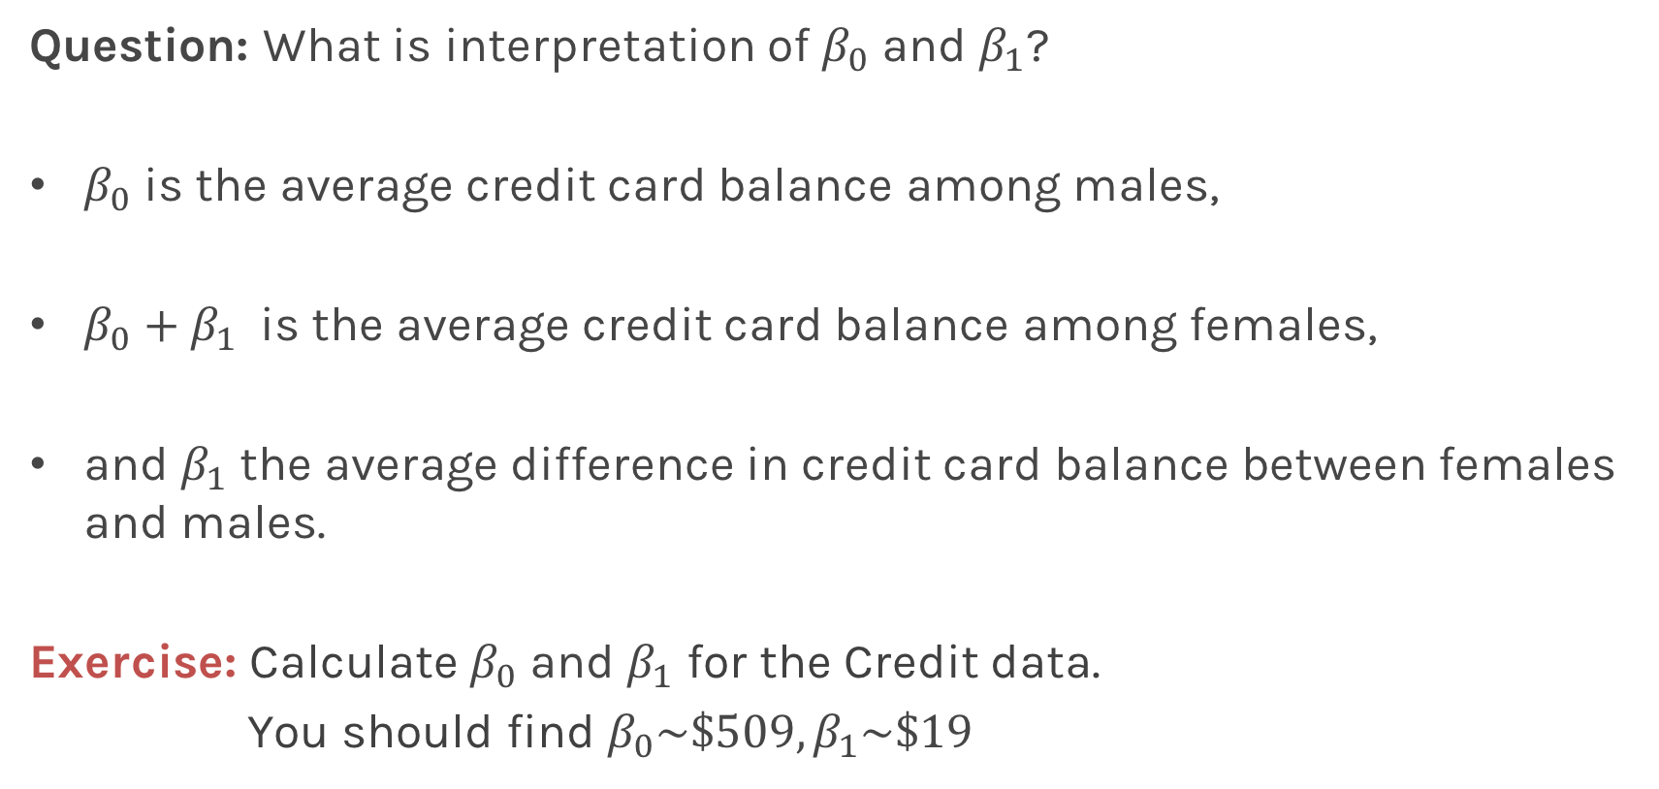
Qualitative Predictors
Question: What is interpretation of $β_{0}$ and $β_{1}$?
$β_{0}$ is the average credit card balance among males,
$β_{0}+β_{1}$ is the average credit card balance among females,
and $β_{1}$ the average difference in credit card balance between females and males.
Exercise: Calculate $β_{0}$ and $β_{1}$ for the Credit data.
You should find $β_{0}\sim \$509,β_{1}\sim \$19$

Slide 39
More than two levels: One hot encoding
Often, the qualitative predictor takes more than two values (e.g. ethnicity in the credit data).
In this situation, a single dummy variable cannot represent all possible values.
We create additional dummy variable as:

Slide 40
More than two levels: One hot encoding
We then use these variables as predictors, the regression equation becomes:
Again the interpretation
Notes:
[ADD interpretation and ONE HOT ENCODING]

Slide 41
Collinearity
Explain collinearity and all that jazz …
Notes:
[ADD interpretation and ONE HOT ENCODING]

Slide 42
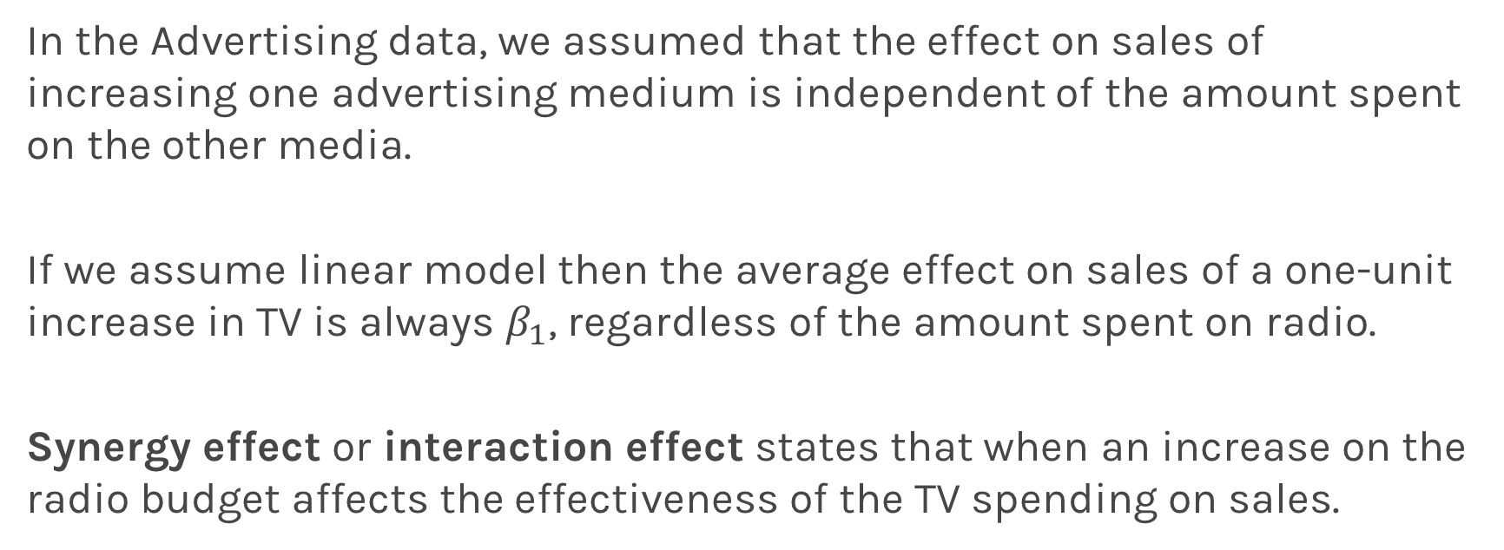
Beyond linearity
In the Advertising data, we assumed that the effect on sales of increasing one advertising medium is independent of the amount spent on the other media.
If we assume linear model then the average effect on sales of a one-unit increase in TV is always $β_{1}$, regardless of the amount spent on radio.
Synergy effect or interaction effect states that when an increase on the radio budget affects the effectiveness of the TV spending on sales.

Slide 43
Beyond linearity
We change
To

Slide 44
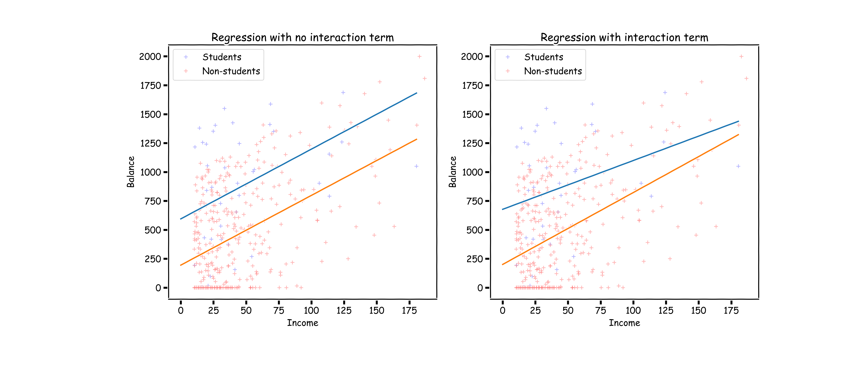
What does it mean?

Slide 45
Predictors predictors predictors
We have a lot predictors!
Is it a problem?
Yes: Computational Cost
Yes: Overfitting
Wait there is more …

Slide 46
Polynomial Regression

Slide 47
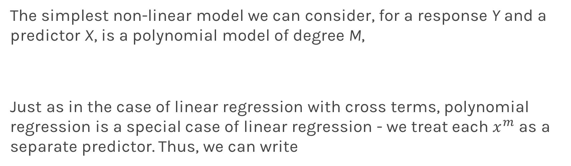
Polynomial Regression
The simplest non-linear model we can consider, for a response Y and a predictor X, is a polynomial model of degree M,
Just as in the case of linear regression with cross terms, polynomial regression is a special case of linear regression - we treat each $x^{m}$ as a separate predictor. Thus, we can write

Slide 48
Polynomial Regression
Again, minimizing the MSE using vector calculus yields,

